Slide 1

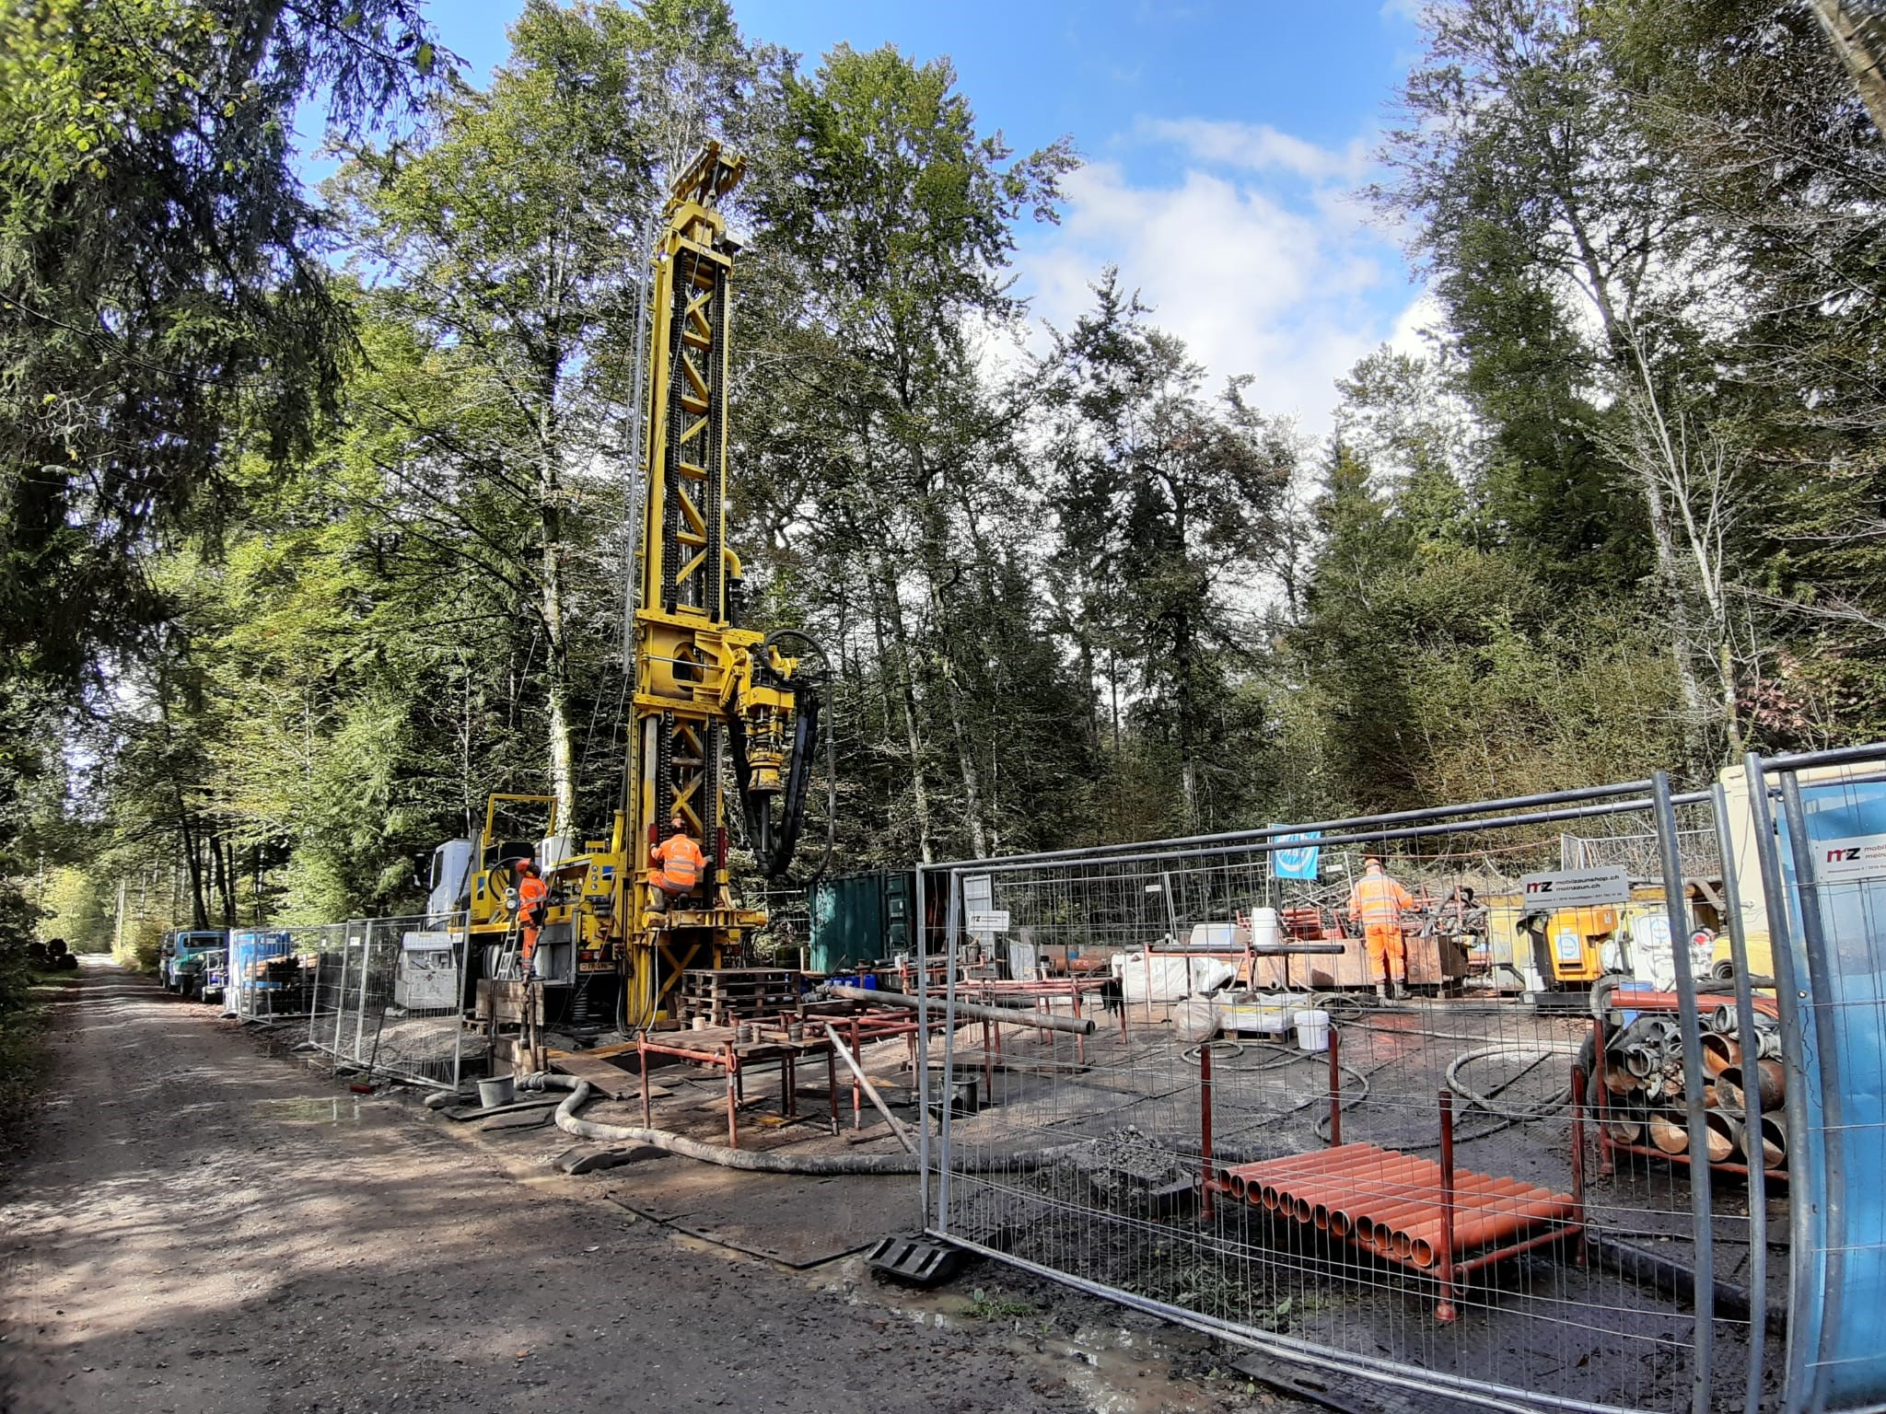


Image-based Classification of Sediments in Drill Cores
ADS CAS Final Project
10.08.2025
Patricio Becerra and Sebastian Schaller

Slide 2
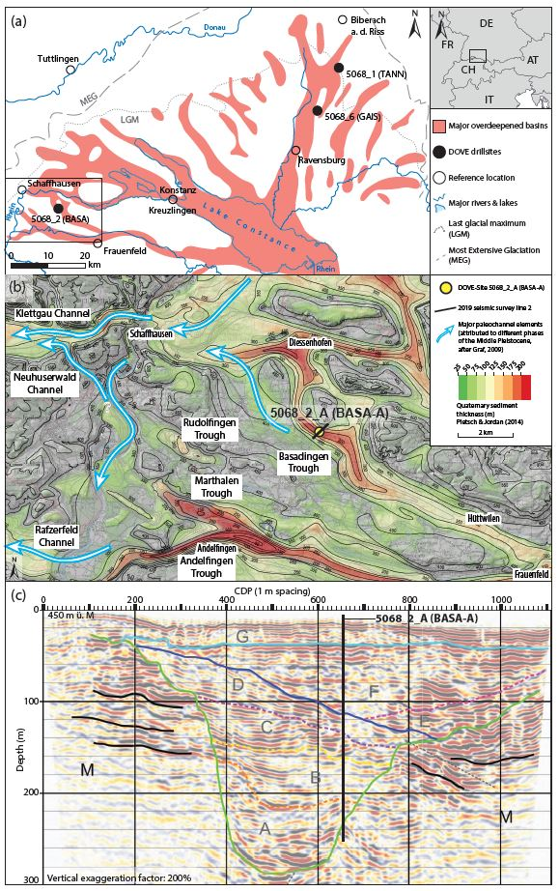
Introduction and background
Glacial extents of the Rhine Glacier
Seismic line
Local overdeepenings
Drill core

Slide 3
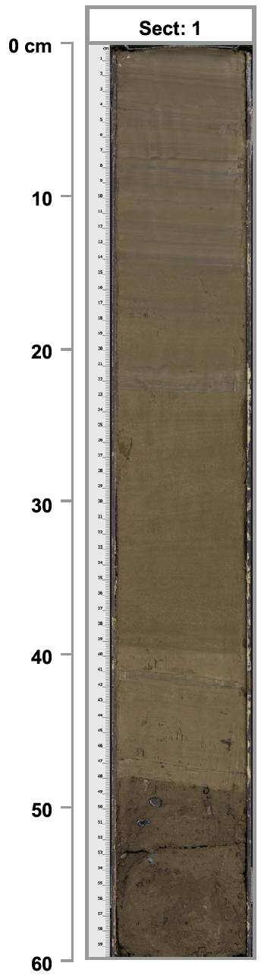
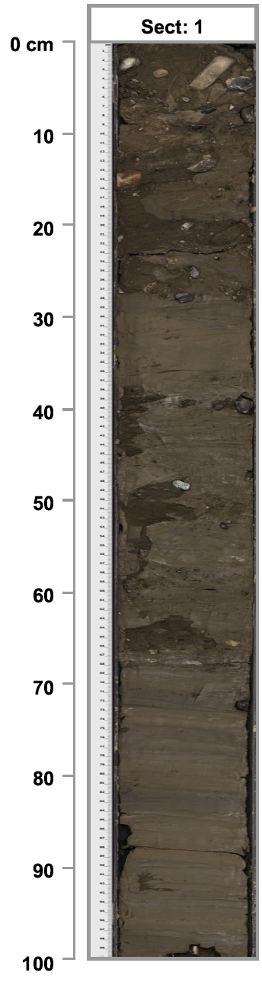
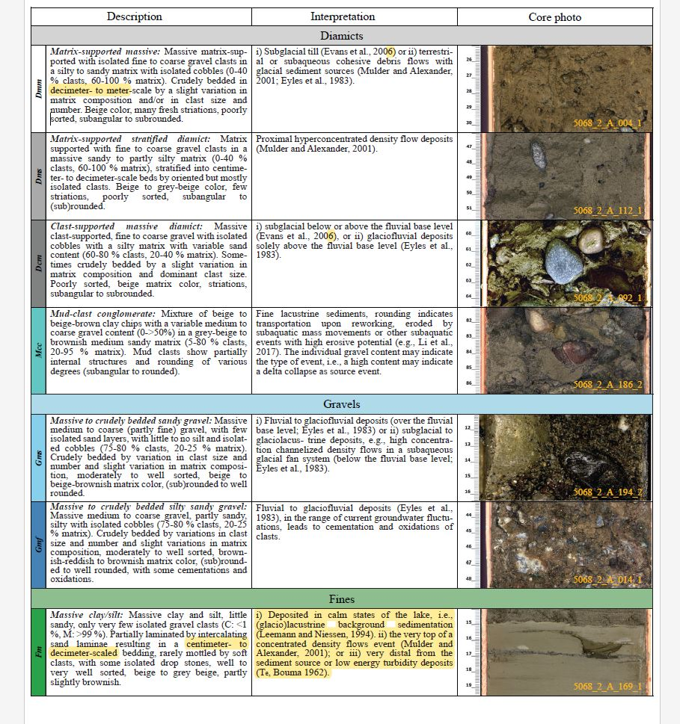
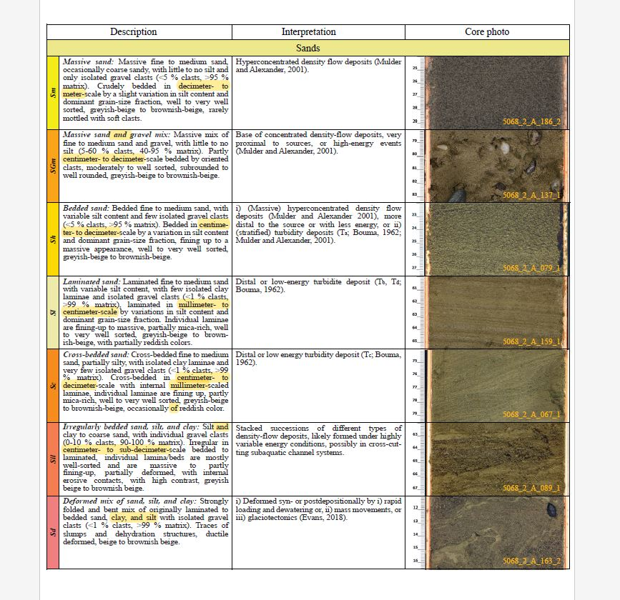
Introduction and background
High-resolution scanned images of sediment drill cores were used to classify the unconsolidated sediments into several lithoclastic types (e.g. gravel, sand, or fine clays)
The goal of our Module 6 project was to set the foundation for a deep learning model that can classify the sediments in a drill core image
The full Image Segmentation model, presented here, is Patricio’s half of our CAS project (the other half was presented by Sebastian and is now part of a paper in press in a specialised sedimentology journal)
Diamict
Gravel
Advantages (see Becerra M1 CDR):
Visual litho-classification takes months
Optimizes the development of stratigraphic models
Sand
Fines

Slide 4
Project Tasks & Objectives
Create training, test and validation datasets from a subset of the previously visually litho-classified images
Label the image data → i.e. manually create image segmentation masks for the selected subset of previously classified images
Write a basic model based on similar image segmentation models in the literature [e.g. DiMartino et al., 2023*]
Evaluate initial results and indicate likely future steps
*Di Martino et al., Nature Scientific Reports (2023), 13:20409, https://doi.org/10.1038/s41598-023-47546-2

Slide 5
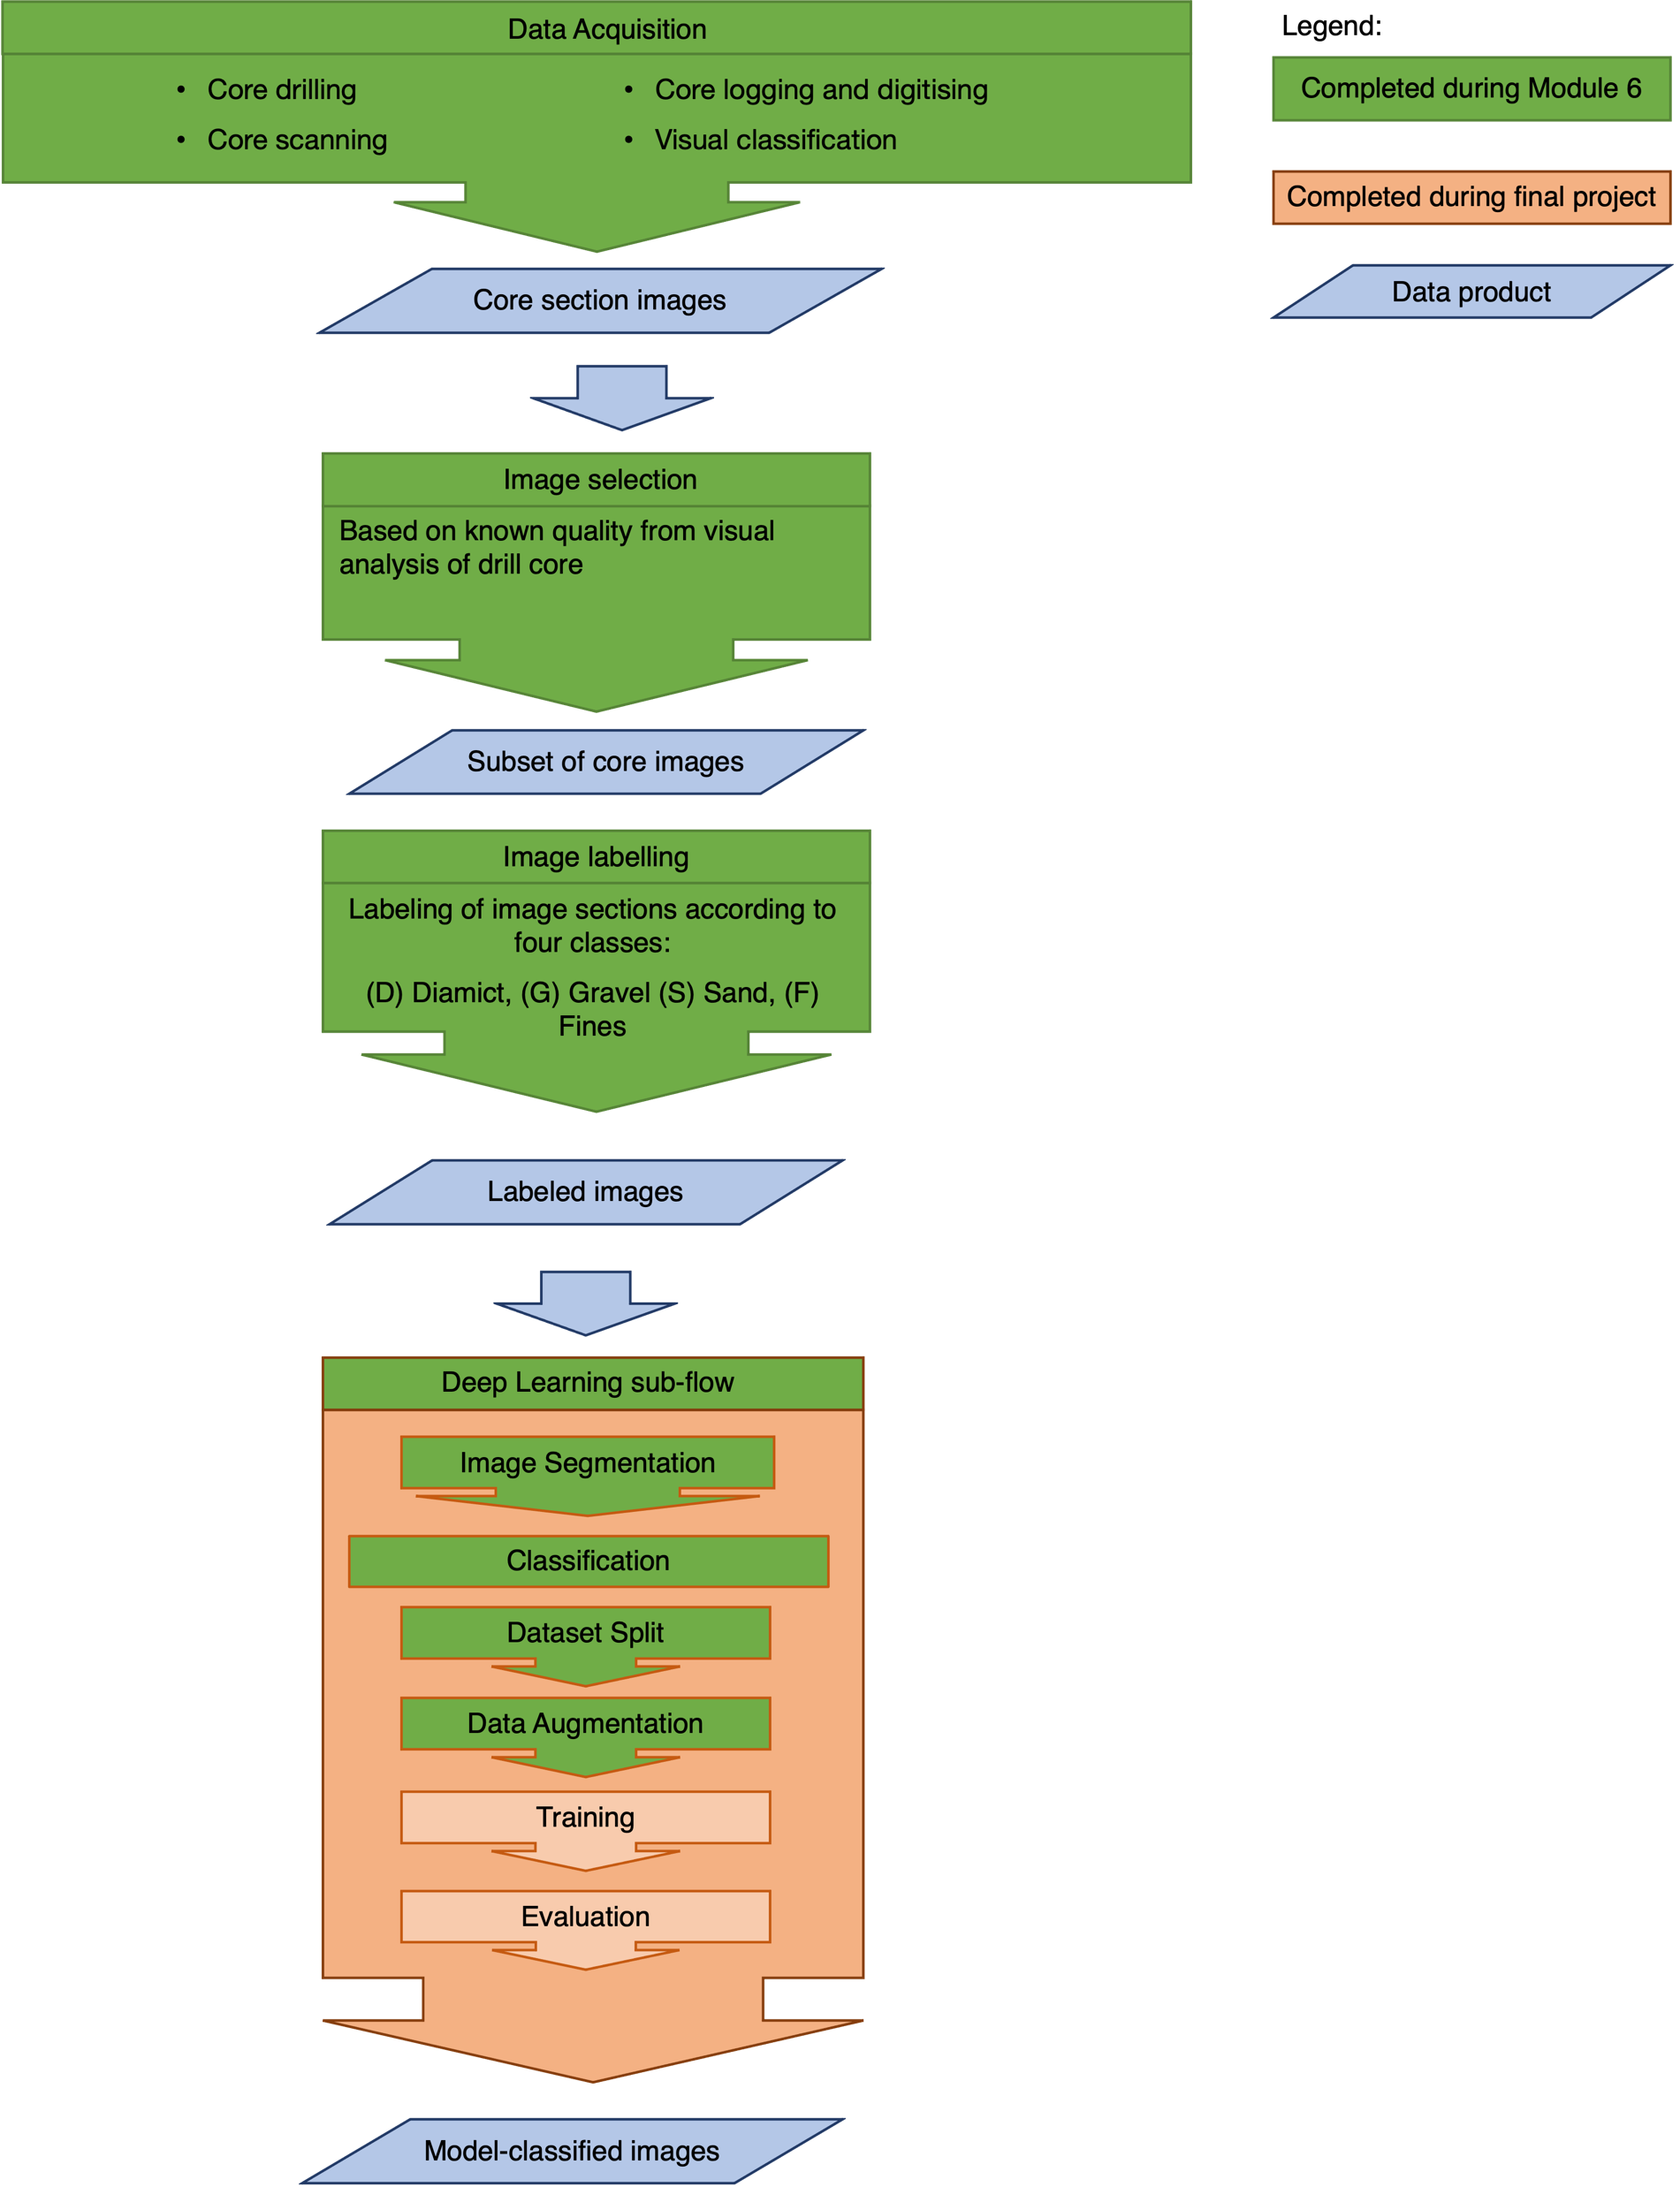
Data flow
Several steps of the workflow were completed during the CAS modules
The initially envisioned final project goal (The construction of image and data-based stratigraphic columns to cross-correlate with each other and with the visual-based stratigraphic column) was unfortunately not achievable in the CAS scope and timeframe
Nevertheless, the classification of images by the deep learning model was achieved with an acceptable degree of accuracy and success.

Slide 6
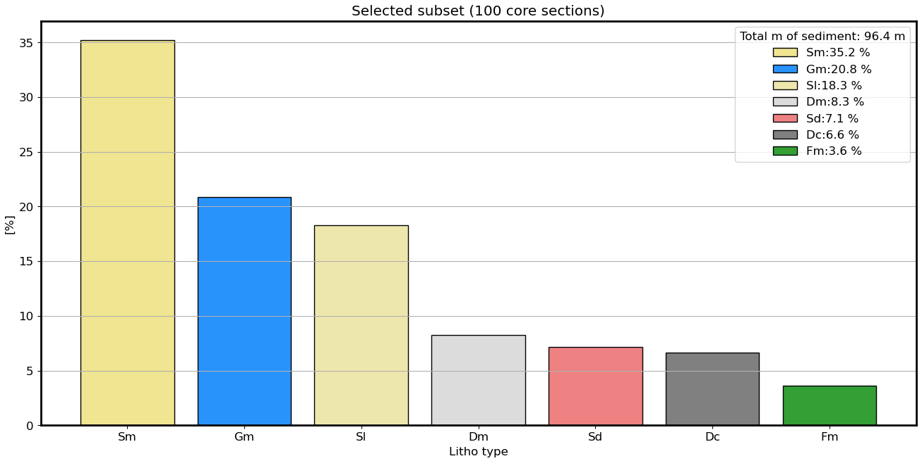
Dataset selection
The bar plot below shows the distribution of lithoclasses of 8 different types, defined in Schaller et al. 2023*, in 100 core sections taken from the BASA_A site (see slide 1).
*Schaller, S., et al., Sci. Dril., 32, 27–42, 2023 https://doi.org/10.5194/sd-32-27-2023

Slide 7
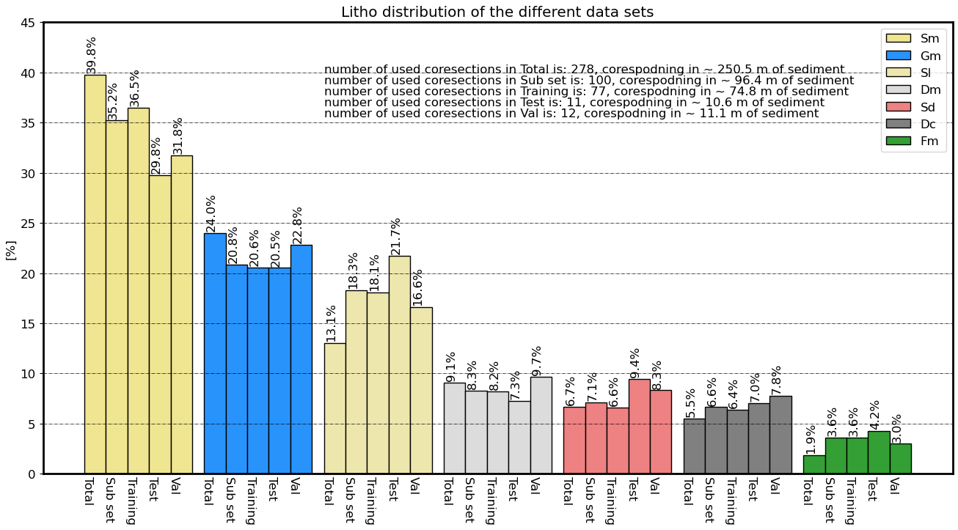
Dataset selection
The plot below shows the distribution of each lithoclass within the total number of sections in each model dataset (validation, test and training)

Slide 8
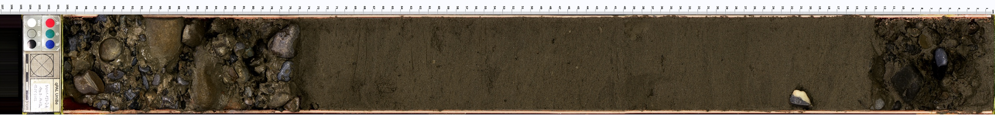

Data labelling: Manual image segmentation
Segmentation masks were manually created for each of 100 images, to be used for training the model. An example image and its mask are shown here.
Massive Gravel (Gm)
Massive Gravel (Gm)
Laminated Sand (Sl)
The images and masks from all of the data subsets were then cropped into square sections of equal 352x352px dimensions to be used by the model (see next slide).

Slide 9
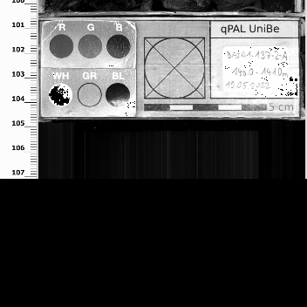
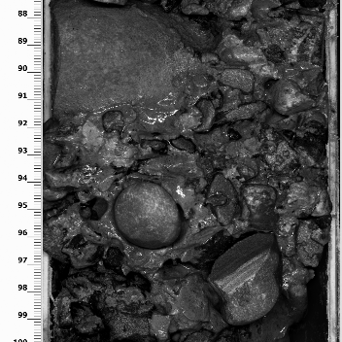
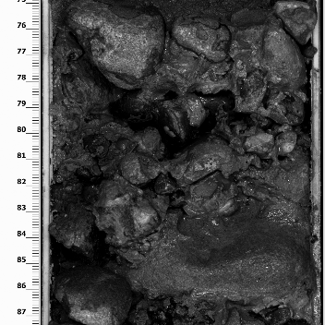
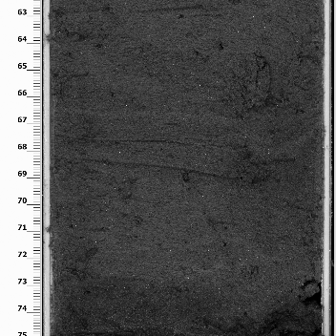
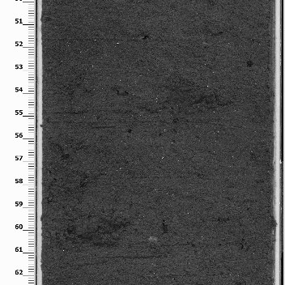
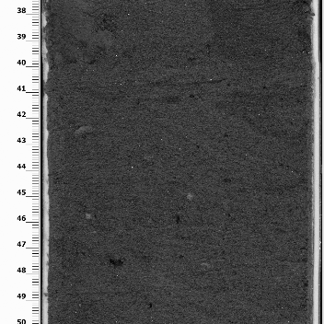
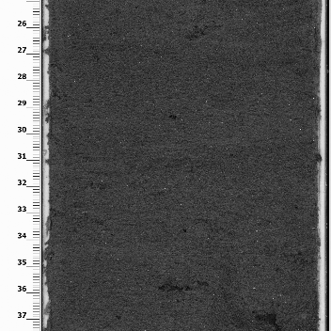
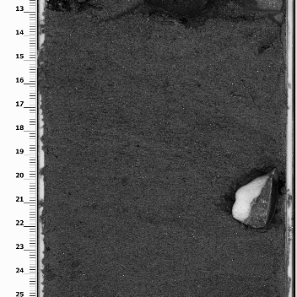
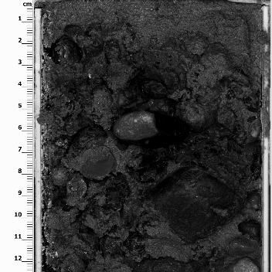





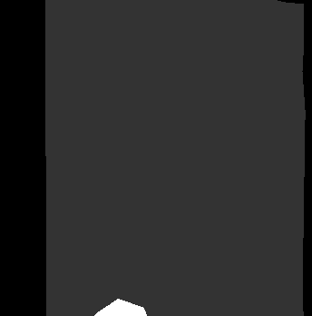
Data Processing: Image splitting
Massive Gravel
Massive Gravel
Laminated Sand

Slide 10
Deep-learning model
Model architecture: U-Net (Tensorflow). Selected based on DiMartino et al., 2023
Used tutorial model: https://youtu.be/XyX5HNuv-xE?si=ywxtReVqf1nxxlzZ
Number of classes:
8 classes (as defined in slides above): First attempt during M6. Further runs improved during final project.
5 classes: Improving classification accuracy by reducing the number of classes through knowledge-based grouping of the existing classes
Optimizer: Adam
Loss functions attempted: Categorical cross-entropy; Focal loss
Datasets:
77 images for training, split into square sections of 352x352 → 672 sections for training
Used train_test_split
Additionally had set of 12 images, i.e., 100 sections for validation
Tested several epochs and batch sizes

Slide 11
Summary of model runs
The model was first run and trained with the original 8 classes on the training set (77 full images → 672 square image sections)
The best model found used random splitting of test and train subsets (train_test_split) within the training set of images. It used 40 epochs, 10 batches, and a categorical_crossentropy loss function
The model was saved (Model5_random_catXent_8classes.keras) and then ran on the validation set of images (12 full images → 100 sections)
The model was then trained and run again but using only 5 classes
The other parameters remained the same (random splitting of test and train subsets within the training set of images, 40 epochs, 10 batches, and a categorical_crossentropy loss function)
The model was saved (Model6_random_catXent_5classes.keras) and then ran on the validation set of images (12 full images → 100 sections)
Summary of results in the following slides

Slide 12
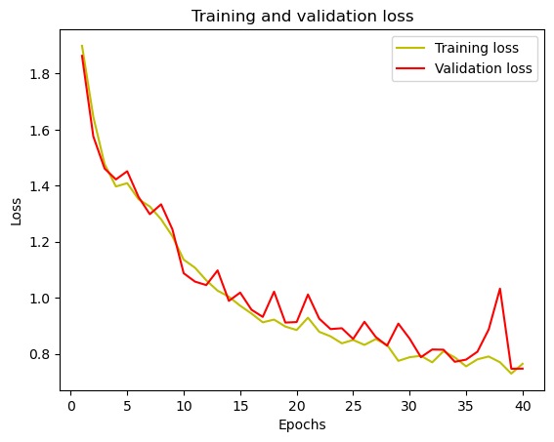
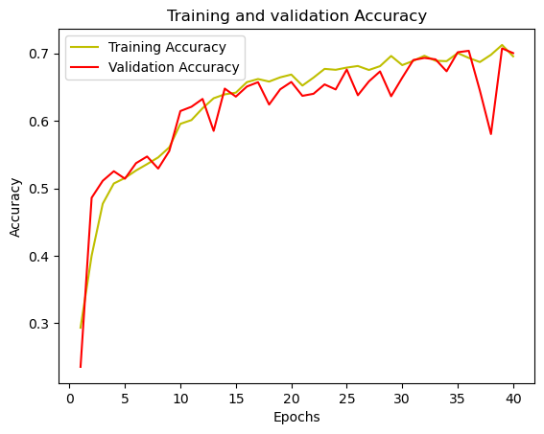
Results: 8 classes.
Best model: Random splitting, 40 epochs, 10 batches, categorical_crossentropy

Slide 13
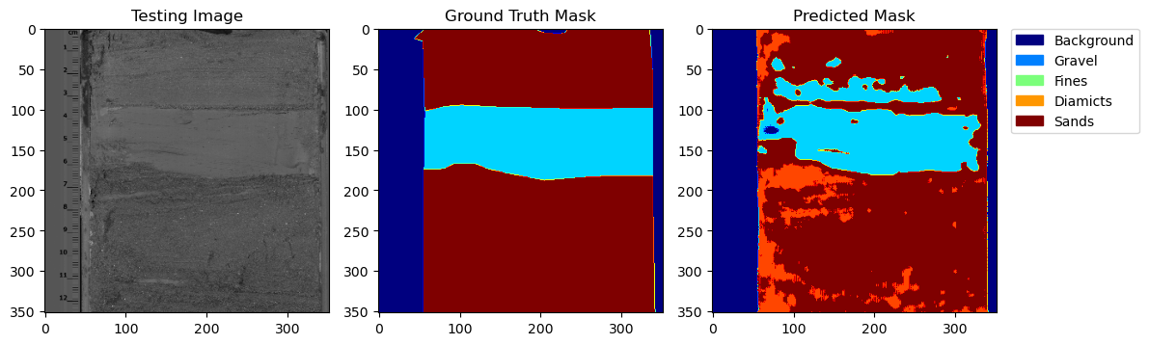
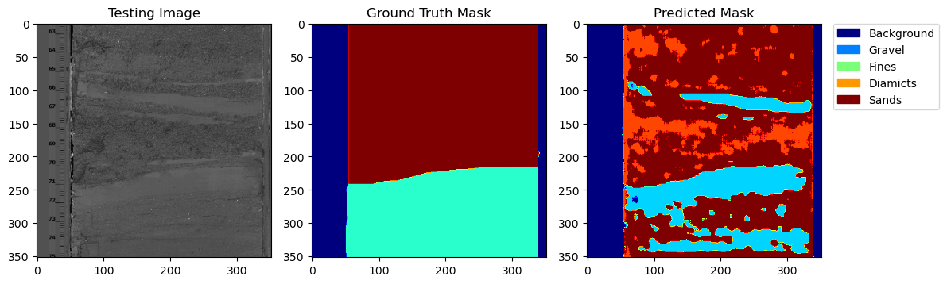
Results: 8 classes. Training Set
Sample image results
Validation set selected through train_test_split
ImId: 20
Good segmentation
Accuracy is: 70.04%
Mean IoU is: 0.46
IoU of class 0 is: 0.8902197
IoU of class 1 is: 0.7094859
IoU of class 2 is: 0.4088437
IoU of class 3 is: 0.2409902
IoU of class 4 is: 0.6543245
IoU of class 5 is: 0.5121779
IoU of class 6 is: 0.26509157
IoU of class 7 is: 3.5232415e-06
ImId: 38
Mediocre segmentation

Slide 14
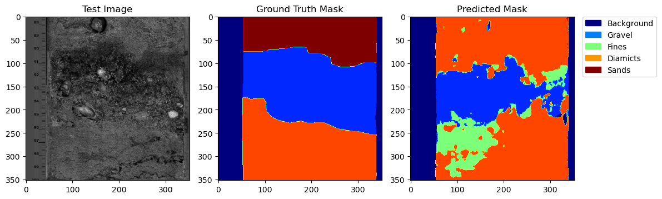
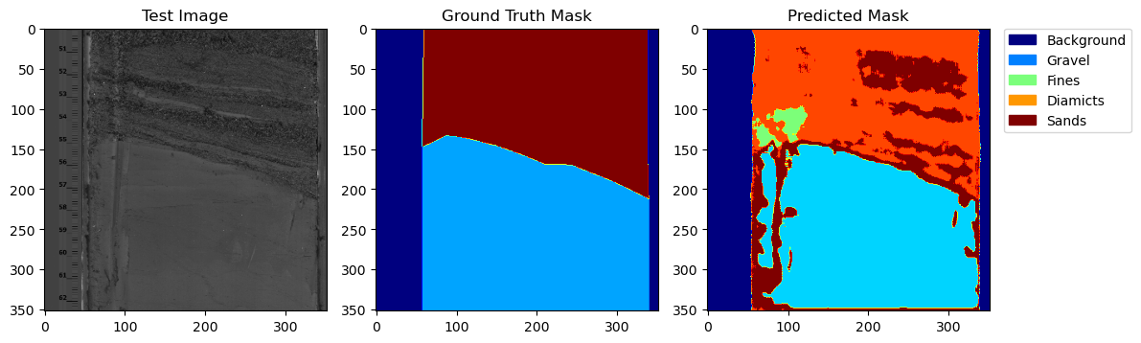
Results: 8 classes. Validation set
Sample image results
Manually selected validation set.
Not part of training set
ImId: 39
Validation Accuracy: 69.66% Mean IoU = 0.4170231
IoU of class 0 is: 0.9467
IoU of class 1 is: 0.6159
IoU of class 2 is: 0.6125
IoU of class 3 is: 0.1718
IoU of class 4 is: 0.2560
IoU of class 5 is: 0.4906
IoU of class 6 is: 0.2426
IoU of class 7 is: 0.0000
ImId: 81

Slide 15
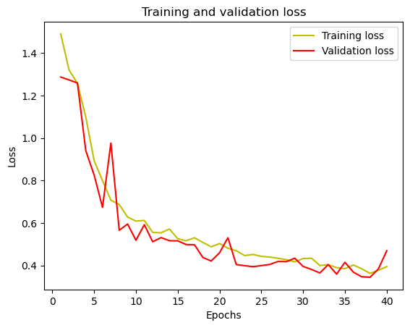
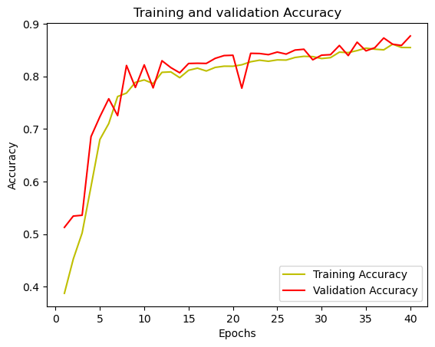
Results: 5 classes
The 8 original classes were re-mapped as follows:
0 = Background
1 = Gravel
2 = Fines
3, 4 = 3 = Diamicts
5, 6, 7 = 4 = Sands
Other parameters remained the same as above:
Random splitting, 40 epochs, 10 batches, categorical_crossentropy

Slide 16
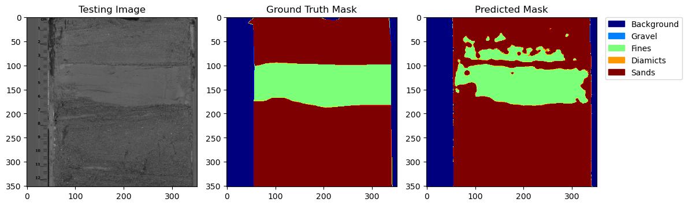
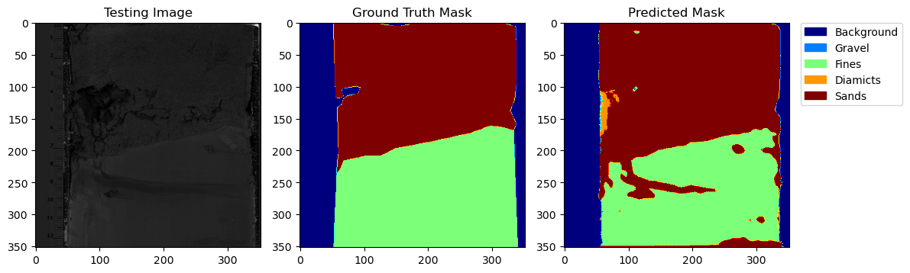
Results: 5 classes. Training Set
Accuracy is: 87.67%
Mean IoU is: 0.6541
ImId: 20
iou of class 0 is: 0.8946
iou of class 1 is: 0.5899
iou of class 2 is: 0.4965
iou of class 3 is: 0.1880
iou of class 4 is: 0.8910
ImId: 51

Slide 17
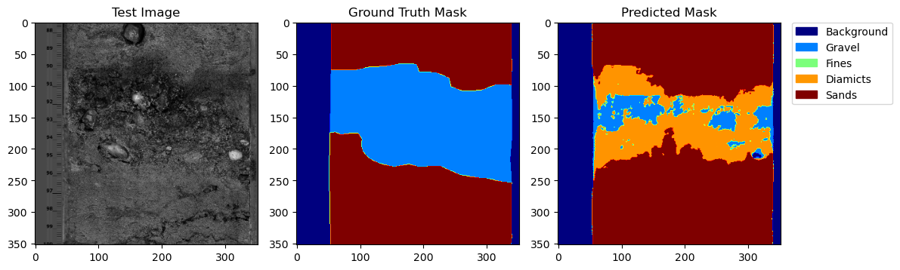
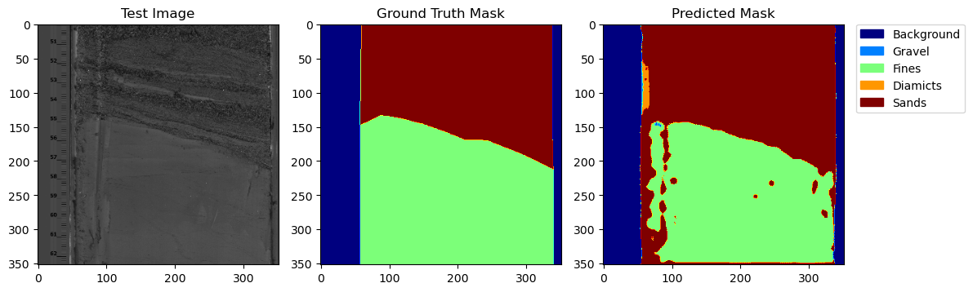
Results: 5 classes. Validation Set
Accuracy is: 83.61%
Mean IoU is: 0.6497
ImId: 39
IoU of class 0 is: 0.9148
IoU of class 1 is: 0.5881
IoU of class 2 is: 0.6726
IoU of class 3 is: 0.2693
IoU of class 4 is: 0.8041
ImId: 81

Slide 18
Conclusions
The basic model constructed achieves its desired objective of classifying lithologies within stratigraphic images with an acceptable degree of accuracy
There is a noticeable improvement in the metrics of classification when reducing the number of classes for classification from 8 to 5.
The model seems to be especially good at classifying sands and fines, and has a harder time classifying gravel or diamicts in a way consistent with the human-led classification
However, this could be used as an advantage, as in many images, the model identified large boulders within a gravel section as diamicts, when the visual classification had simply classified the whole section as gravel → this differentiation could be harnessed to explore a more detailed classification or to identify the presence of clasts over a certain size threshold
Notes:
Patricio (30 sec)

Slide 19
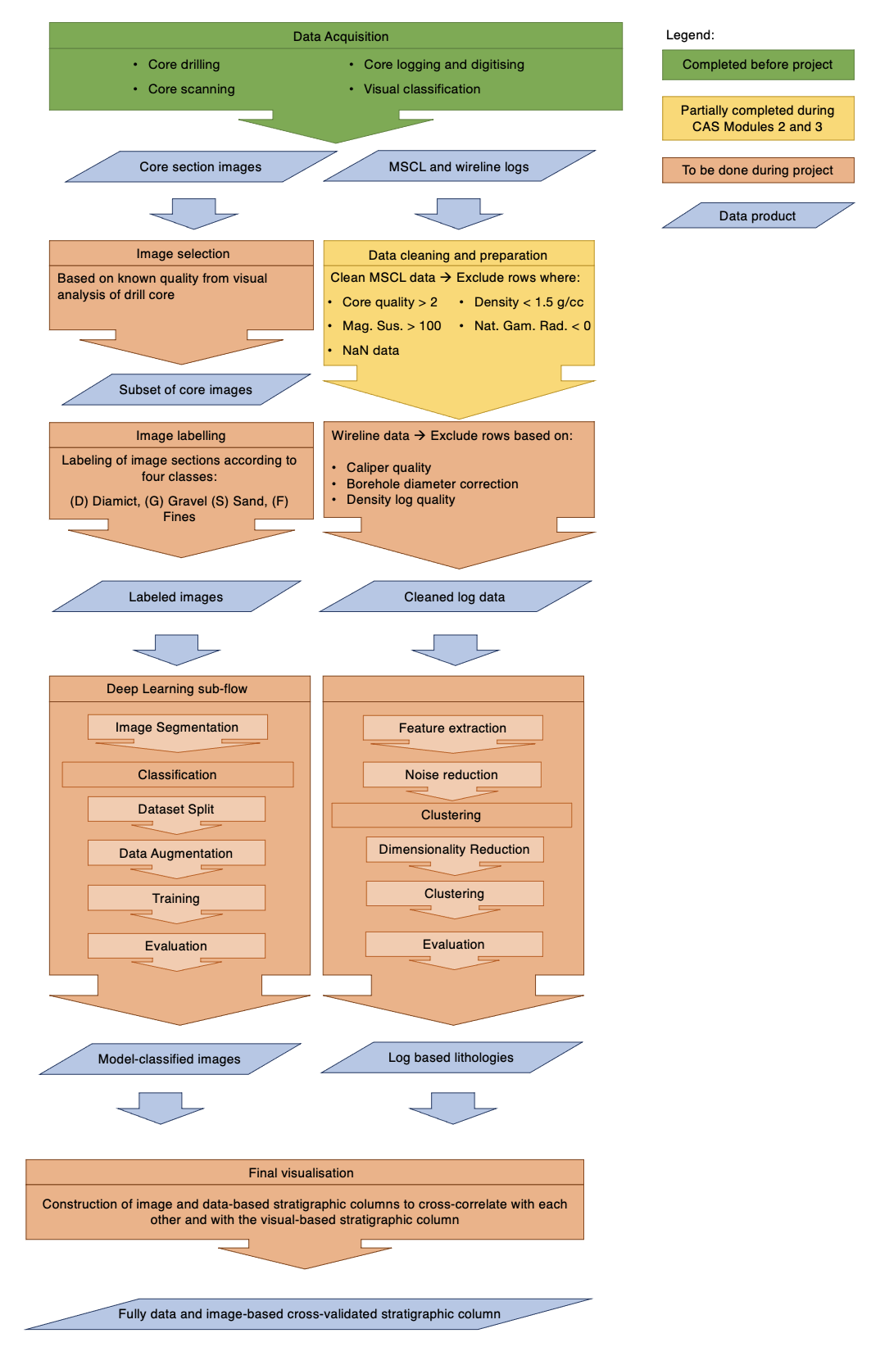
Steps to take the project further
Increasing the training dataset using the set of up to 1000 images available would undoubtedly improve the model performance, but would require much more computing power.
Improve Deep Learning toolset : Tensorflow → Pytorch.
Try U-Net pre-trained on ImageNet with various backbones (e.g. EfficientNet) instead of training it ourselves.
Data augmentation through various image transformations could also increase the quality of the model.
Notes:
Patricio (30 sec)

